Slide 1
First checkpoint
Sum-AppAudio-Group 4
Marco Carfora
Daniele Calisi
Francesco Bovi

Slide 2
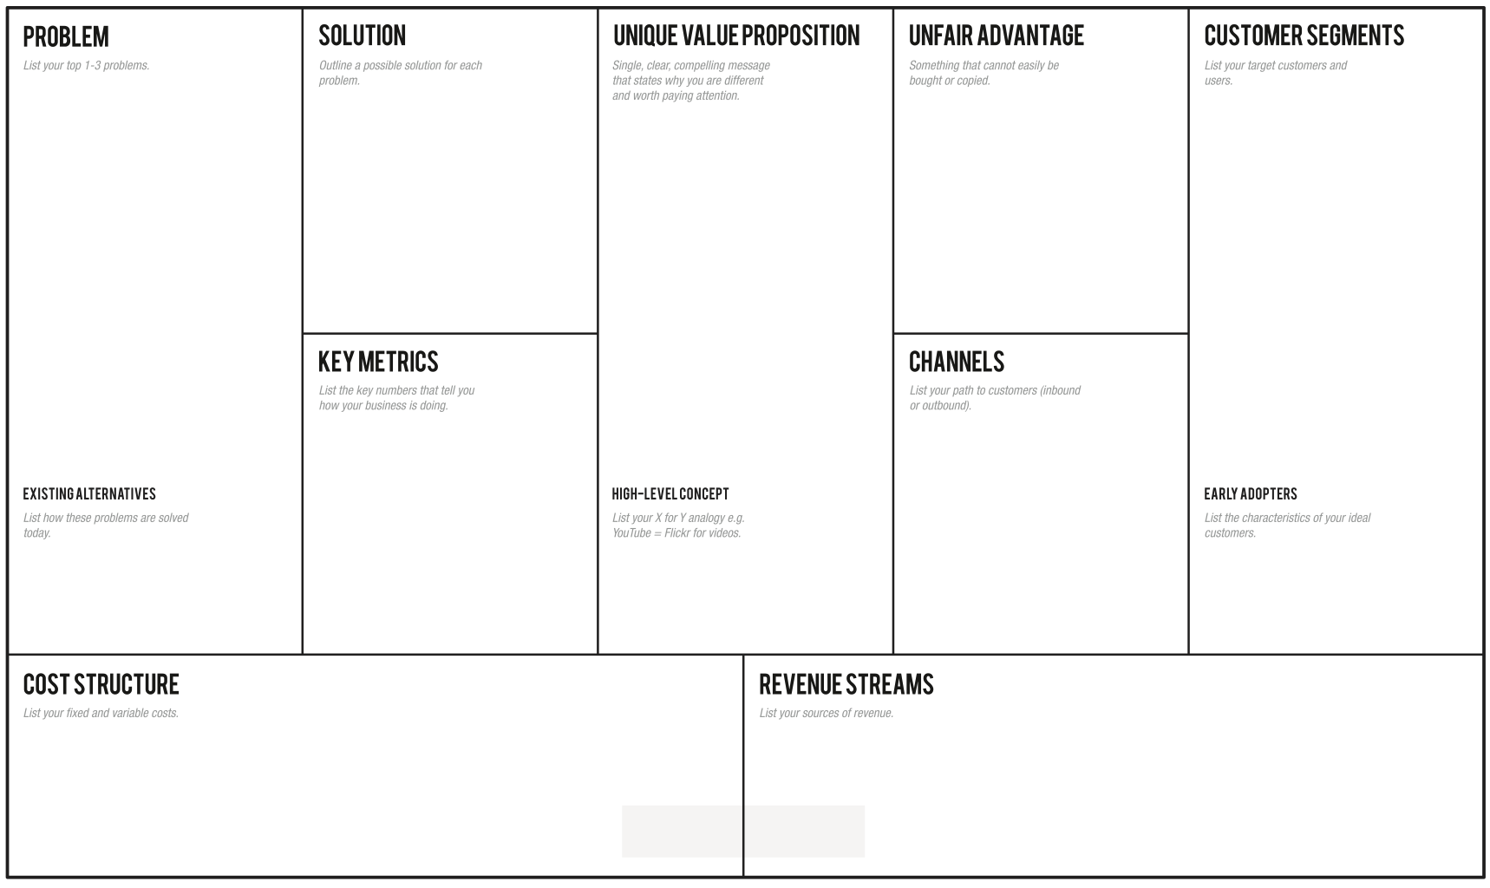
-Students with dyslexia have difficulties in reading and comprehending a text:
-They don’t have a way to easily grasp the concepts, making the learning slow.
-They need an easy way to autonomously review school subjects, indeed they usually ask for external help
Through the app the students can learn in an easier and efficient way, avoiding tiring readings, relying on recordings from a huge collection built thanks to a lot of students' support
Overcome your reading and learning difficulties, enjoy a student-to-student model whose core are the recorded files that every student can upload to summarise subject topics or book chapters for students with dyslexia.
-Students with dyslexia problems (2% from primary schools, 5.6% from middle schools, 4.7% from high schools).
-Schools and pedagogical associations -Support teachers.
-Every student who want to earn some money while helping others.
-Number of produced and listened recordings (monthly).
-Content quality trends thanks to feedback system.
-How many results appear for a single topic.
-How many people use the app regularly (rate of accesses)
-Flyers distribution in front of selected schools and associations of this sector.
-A social page dealing with dyslexia problem.
-Meetings in school where we present our project to students.
- Select classes with a dyslexic student in Rome schools, so classmates can help each other -Tutors / Support teachers
Skuola.net, ad hoc textbooks, Youtube, voice synthesizers, tutors, concept maps
Sum-AppAudio = Spotify for school summaries.
-Server/database maintenance;
-Channels’ cost;
-(Eventually) Reward system costs (Gift Cards);
- Cost of the application in the mobile store;
- Partnerships with schools/associations;
- Partnerships with publishing companies to certify their content;
- Banner advertisements;

Slide 3

Validation Plan
Assumptions to be validated:
How:
The interest of dyslexic students and tutors to use the app;
The interest of non-dyslexic students to upload recorded files;
The usefulness of the audio model for dyslexic students; .
Our revenue streams;
Surveys/questionnaires on social networks; .
MVP: give audio files to dyslexic students verifying their comprehension quality;
Search for revenue information about mobile store and banner functioning;

Slide 4
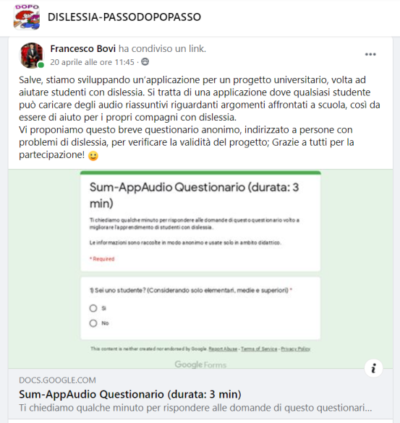
Students Questionnaire
CONTENT SUMMARY:
Degree of satisfaction with the current study method.
Degree of satisfaction with the supporting material available (only for dyslexic students).
Usefulness of the student-to-student audio system.
Availability in uploading recordings (with or without incentives).
Addressed to: Scholars and ex-students, dyslexic and not.
Where: Our contacts, facebook groups about dyslexia.
Questionnaire Link: https://forms.gle/JzLLyL3t9WeL8Aqm6

Slide 5
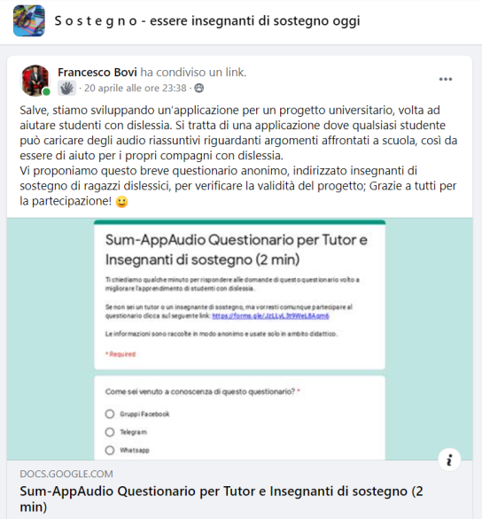
Tutor
Questionnaire
CONTENT SUMMARY:
Degree of satisfaction with student’s current study method.
Degree of satisfaction with the supporting material available.
Usefulness of the student-to-student audio system.
Availability in the evaluation of the recordings.
Addressed to: Support teachers and private tutors;
Where: Our contacts, facebook groups about school tutoring;
Questionnaire Link:
https://forms.gle/CLrzM3CAkxBQKcDU7

Slide 6

Minimum Viable Product
What:
To verify the usefulness of the audio system for dyslexic students, we have contacted a few and provided them some audio recordings; they listened the audio and evaluated the quality, thus to give us a feedback.
Audio samples:
Addressed to: Dyslexic students;
Where: Through our contacts (family, friends, acquaintances)
Respiratory System
Assyrians
Athens
Sparta

Slide 7
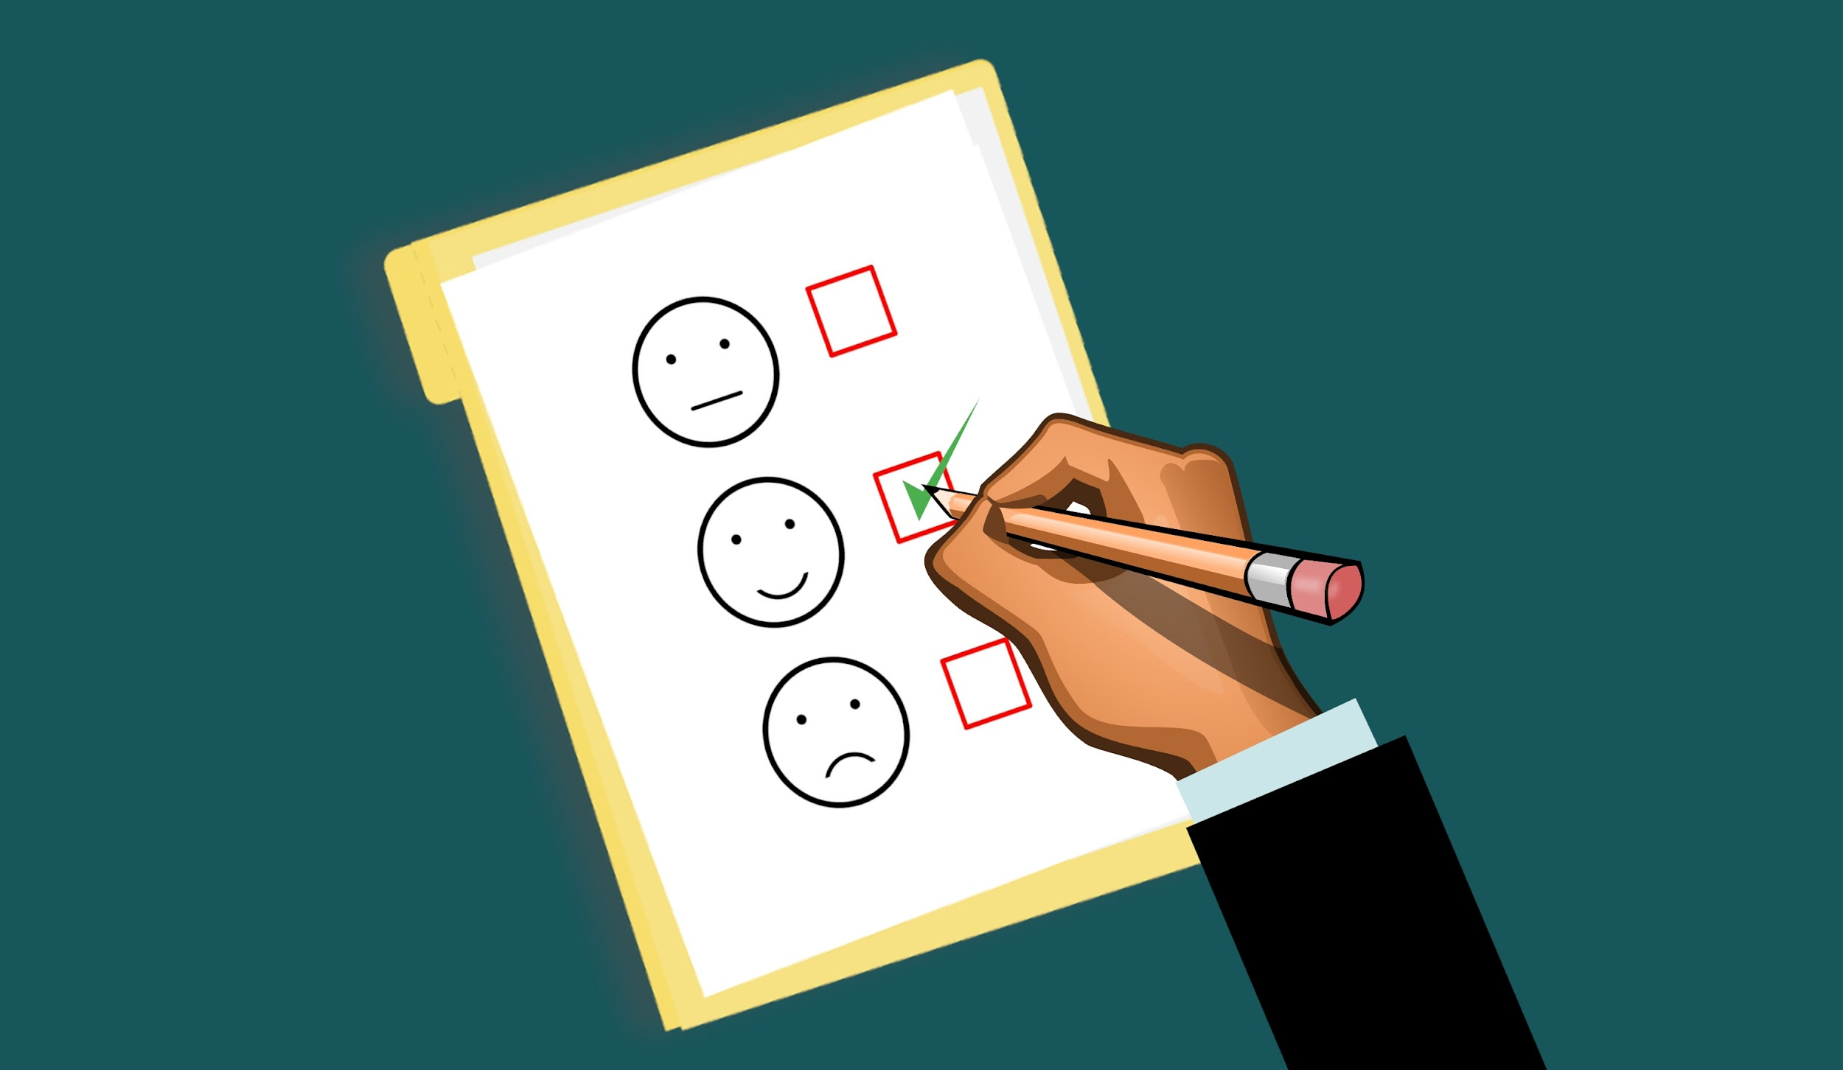
Results
MVP feedbacks: 8
5 fully positive;
2 good, but they advise to add concept maps;
1 negative feedback;
Questionnaire feedbacks: 41
80% fully positive;
15% good, but they advise to add concept maps;
5% negative feedbacks;
Actions in view of the results:
-New feature: optional concept maps together with audio files;
How to extend the MVP audience:
-Landing page (Facebook) that includes audio tests for dyslexics to be shared on Facebook groups;
Notes:
Stonks

Slide 8
THANK
YOU!

